Slide 1
.NET CRYSTAL REPORTS
…Vishal Kumar.

Slide 2
INTRODUCTION TO CRYSTAL REPORT:-
For creating interactive reports that can be integrated into a wide range of Windows and Web applications.
Visual Studio .NET 2002 introduced a newer version, Crystal Reports .NET.
Data present to users via Crystal Reports is way beyond the basic formatting.

Slide 3
WHAT IS CRYSTAL REPORTS:-
A report design tool that allows you to create reports capable of retrieving and formatting a result set from a database or other data source.
Crystal Reports has its own formula language for creating calculations.
Crystal Reports also features a number of application Programming Interfaces (APIs).

Slide 4
WHAT CAN WE DO WITH CRYSTAL REPORTS:-
Crystal Reports .NET includes an integrated Report Designer available within the Visual Studio IDE that can be used to create report files (.rpt) to integrate with the application.
The Report Designer guides us through the report development process, from selecting a data source and the field that will appear on the report, to determining what records should appear.

Slide 5
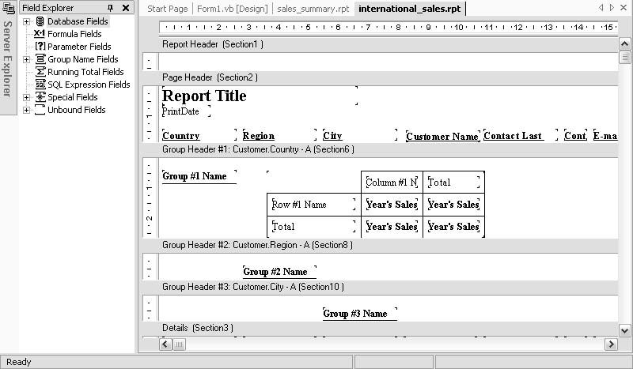
WHAT CAN WE DO WITH CRYSTAL REPORTS:-

Slide 6
WHAT CAN WE DO WITH CRYSTAL REPORTS:-
Crystal Reports.NET has two different viewers.
1. The Windows Forms Viewer –
can be used with Windows applications to preview any reports we have integrated into the application.
2. Web Forms Viewer –
Allows us to view reports we have integrated into the Web applications.

Slide 7
Demo

Slide 8
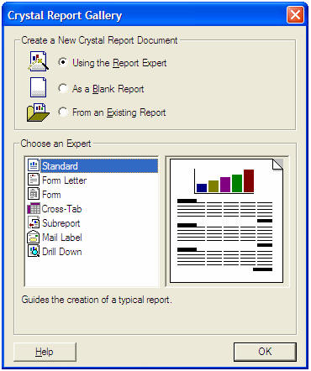
CREATING A CRYSTAL REPORT:-
Adding a Report to the Application-

Slide 9
CREATING A CRYSTAL REPORT:-
Using the Report Expert:
- Number of different report experts available to walk us step-
by-step through creating a report.
As a Blank Report:
- For experienced developers who are familiar with the Report
Designer and want to build a report up piece by piece.
- A good way to produce a report that is leaner and has fewer
overheads built into it.
From an Existing Report:
- Existing reports serve as basis.
- The experts are not available.

Slide 10
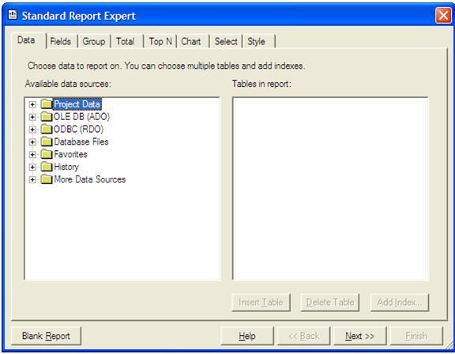
CREATING A CRYSTAL REPORT:-
Selecting the Data Source:

Slide 11
CREATING A CRYSTAL REPORT:-
Project Data:
-Crystal Reports .NET can leverage the ADO .NET Framework and report directly from datasets that appear in your application.
OLE DB (ADO):
-This folder is for data sources that can be accessed through OLE DB, including SQL Server, Oracle, and Microsoft Jet 3.51/4.00–accessible data sources.
ODBC (RDO):
-This folder is for data sources that can be accessed through an ODBC-compliant driver. It also allows to enter SQL command.

Slide 12
CREATING A CRYSTAL REPORT:-
Database Files:
-This folder includes a number of file-type database formats, including Access, Excel, XML, and Crystal Field Definition files.
More Data Sources:
-These include reporting directly from XML files, Access/Excel through DAO, and Crystal Field Definition Files.

Slide 13
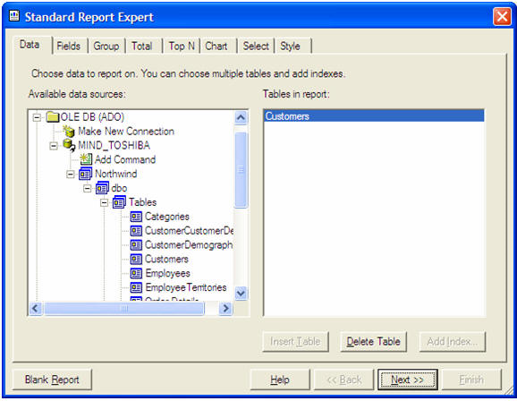

Slide 14
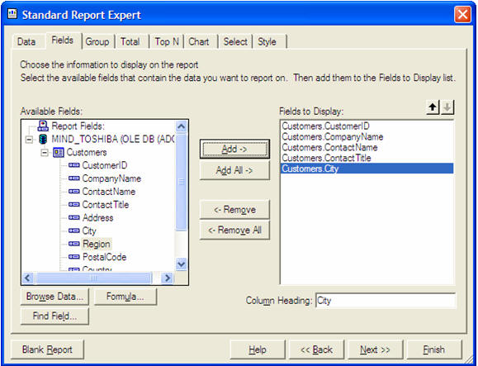
CREATING A CRYSTAL REPORT:-
Choosing the Fields For the Report:

Slide 15
CREATING A CRYSTAL REPORT:-
Choosing the Fields For the Report:
- The fields we have selected here will be inserted into the report’s detail section and a separate line will be printed for each record in the dataset.
- With each field, a corresponding field heading will be added to your report and placed in the page header.

Slide 16
CRYSTAL REPORTS .NET BENEFITS
Leverage Existing Development and Skills
Tight Visual Studio .NET Integration
Windows and Web Report Viewers
ADO .NET

Slide 17
Thank You!

